Slide 1
Predict Sentiment from Movie Reviews by using Artificial Neural Networks
Student : Enes Jashari
Professor : Dr Konstantinos Liagkouras

Slide 2
Announcement on the Project C
During this project I will use experiments to explain algorithms performances.
During the next slides you will come across some experiements that I ‘have done using Artifficial Neutral Networkor to determine the sentiment of the Movie Reviews ,if we have polar movie reviews (positive or negative ) so we don’t have neutral reviews.
These experiments were executed using algorithms that prof. Dr Konstantinos Liagkouras provide for us .

Slide 3
Algorithm.1
import tensorflow as tf
from tensorflow import keras
from tensorflow.keras import layers
# Define our training input and output data with type 16 bit float
# Each input maps to an output
X = tf.constant([[0, 0], [0, 1], [1, 0], [1, 1]], dtype=tf.float16)
Y = tf.constant([[0], [1], [1], [0]], dtype=tf.float16)
# Create a new Sequential Model
model = keras.Sequential()
# Add our layers
model.add(layers.Dense(
4, # Amount of Neurons
input_dim=2, # Define an input dimension because this is the first layer
activation='relu' # Use relu activation function because all inputs are positive
))
model.add(layers.Dense(
1, # Amount of Neurons. We want one output
activation='sigmoid' # Use sigmoid because we want to output a binary classification
))
# Compile our layers into a model
model.compile(
loss='mean_squared_error', # The loss function that is being minimized
optimizer='adam', # Our optimization function
metrics=['binary_accuracy'] # Metrics are different values that you want the model to track while training
)
# Our function to take in two numerical inputs and output the relevant boolean
def cleanPredict(a, b):
inputTens = tf.constant([[a,b]])
return round(model.predict(inputTens)[0][0]) == 1 # model.predict(input) yields a 2d tensor
print(cleanPredict(1,0)) # Will yield a random value because model isn't yet trained
model.fit(
X, # Input training data
Y, # Output training data
epochs=2000, # Amount of iterations we want to train for
verbose=1 # Amount of detail you want shown in terminal while training
)
print(cleanPredict(1,0)) # Should Yield True

Slide 4
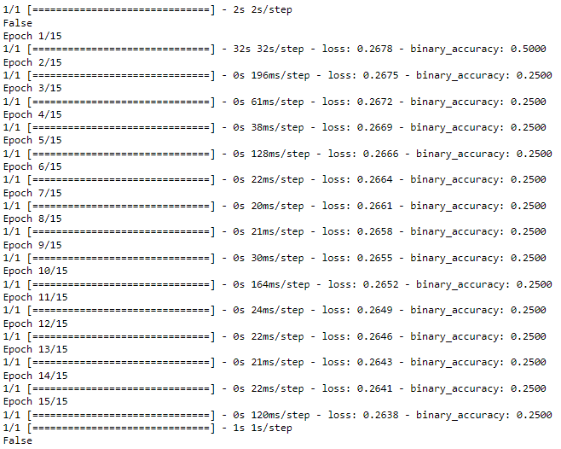
During these experimentation we’re going to change the layer of neuron such as changing the epochs to gain best(different) results.
In my first experiment I used 15 epochs to get best reviews result .
The time of algorithm running it was very fast but not also results.

Slide 5
The best binary_accuracy in above example is equal to 0.2500 and the worst binary_accuracy is equal to 0.5000 , we also got other important result that algorithm prints while it finished it’s process.
The best loss we got is equal to 0.2638 and the worst result we got is equal to 0.2678 .
We see these result and they are the worst we can get,but let’s increase numbers of epochs and see the results.
Now we try with 2000 epochs and see what result we are getting.The results are amazing .
We got almost perfect results with best binary_accuracy that is equal to 1.0000 and with best loss which is euqal to 0.0315 and worst binary_accuracy that is equal to 0.7500 and worst loss that is equal to 0.2668.
Epoch 1/2000
1/1 [==============================] - 9s 9s/step - loss: 0.2668 - binary_accuracy: 0.7500
Epoch 2000/2000
1/1 [==============================] - 0s 19ms/step - loss: 0.0315 - binary_accuracy: 1.0000
1/1 [==============================] - 2s 2s/step
True
15 epochs | Best Result | Worst Result
Binary_accuracy | 0.2500 | 0.5000
Loss | 0.2638 | 0.2678

Slide 6
Now we are going to experiment with higher numbers of epochs to try to get the best possible results
Let’s try with 2700 epochs , and see what result we got .
Epoch 1/2700
1/1 [==============================] - 11s 11s/step - loss: 0.2402 - binary_accuracy: 0.5000
Epoch 2700/2700
1/1 [==============================] - 0s 21ms/step - loss: 9.4512e-04 - binary_accuracy: 1.0000
1/1 [==============================] - 2s 2s/step
True
The algorithm perform was perfect so now we have an overfitting se we didn’t got better results that the example with 2000 epochs , in these cases we take the best possible epoch result.In my case the best epoch result is 2599.
Epoch 2599/2700
1/1 [==============================] - 0s 28ms/step - loss: 0.0010 - binary_accuracy: 1.0000

Slide 7
#Importing libraries
import pandas as pd
import numpy as np
import matplotlib.pyplot as plt
from sklearn.preprocessing import MinMaxScaler
from keras.models import Sequential, load_model
from keras.layers import LSTM, Dense, Dropout
#Loading data
df = pd.read_csv("C:\\Users\\Enes Jashari\\Desktop\\ML Lectures\\25 lesson\\vodafone6.csv")
print(df)
df.shape
#we will just use one variable which is the “open” price.
df = df['Open'].values
df = df.reshape(-1, 1)
#split the data into training and testing sets
dataset_train = np.array(df[:int(df.shape[0]*0.8)])
dataset_test = np.array(df[int(df.shape[0]*0.8):])
scaler = MinMaxScaler(feature_range=(0,1))
dataset_train = scaler.fit_transform(dataset_train)
dataset_test = scaler.transform(dataset_test)
def create_dataset(df):
x = []
y = []
for i in range(50, df.shape[0]):
x.append(df[i-50:i, 0])
y.append(df[i, 0])
x = np.array(x)
y = np.array(y)
return x,y
#create our training and testing data
x_train, y_train = create_dataset(dataset_train)
x_test, y_test = create_dataset(dataset_test)
x_train = np.reshape(x_train, (x_train.shape[0], x_train.shape[1], 1))
x_test = np.reshape(x_test, (x_test.shape[0], x_test.shape[1], 1))
# Model building
model = Sequential()
model.add(LSTM(units=96, return_sequences=True, input_shape=(x_train.shape[1], 1)))
model.add(Dropout(0.2))
model.add(LSTM(units=96,return_sequences=True))
model.add(Dropout(0.2))
model.add(LSTM(units=96,return_sequences=True))
model.add(Dropout(0.2))
model.add(LSTM(units=96))
model.add(Dropout(0.2))
model.add(Dense(units=1))
x_train = np.reshape(x_train, (x_train.shape[0], x_train.shape[1], 1))
x_test = np.reshape(x_test, (x_test.shape[0], x_test.shape[1], 1))
model.compile(loss='mean_squared_error', optimizer='adam')
model.fit(x_train, y_train, epochs=100, batch_size=32)
model.save('stock_prediction.h5')
model = load_model('stock_prediction.h5')
predictions = model.predict(x_test)
predictions = scaler.inverse_transform(predictions)
y_test_scaled = scaler.inverse_transform(y_test.reshape(-1, 1))
fig, ax = plt.subplots(figsize=(16,8))
ax.set_facecolor('#000041')
ax.plot(y_test_scaled, color='red', label='Original price')
plt.plot(predictions, color='cyan', label='Predicted price')
plt.legend()

Slide 8
During this experiment we started with unliked result but during the process I managed to get pretty good results .
I’ve started with these values: Epoch 1/82
24/24 [==============================] - 54s 2s/step - loss: 0.0053
In first epoch I god a loss that is equal to 0.0053 ,that is good but I managed to decrease it and I got even better result.
Let’s see about last epoch:
Epoch 82/100
24/24 [==============================] - 32s 1s/step - loss: 0.0010
In last epoch I managed to improve the result , from 0.0053 to decrease to 0.010 ,These values are pretty good and shows us that we almost fit perfectly the stock.
During next slides you are going to see the visualization about these results

Slide 9
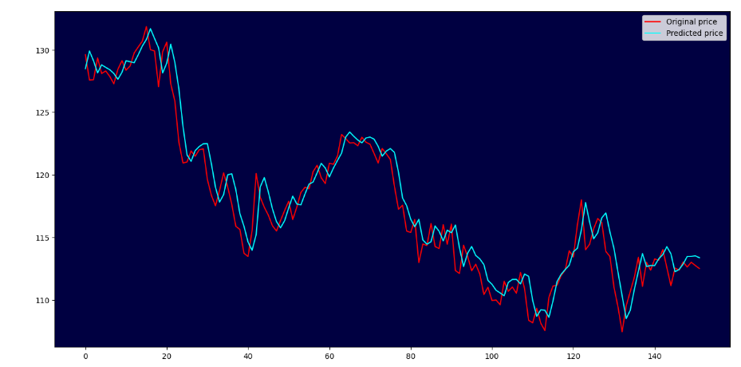

Slide 10
import numpy as np
from tensorflow.keras.datasets import imdb
import matplotlib.pyplot as plt
# load the IMDB dataset
(X_train, y_train), (X_test, y_test) = imdb.load_data()
X = np.concatenate((X_train, X_test), axis=0)
y = np.concatenate((y_train, y_test), axis=0)
# Display the shape of the training dataset
print("Training data: ")
print(X.shape)
print(y.shape)
# Print the unique class values
# It is a binary classification problem for good and bad sentiment in the review
print("Classes: ")
print(np.unique(y))
# Total number of unique words in the dataset - there are under 100,000 words across the entire dataset
print("Number of words: ")
print(len(np.unique(np.hstack(X))))
# Summarize review length
print("Review length: ")
result = [len(x) for x in X]
# Average review length and standard deviation
print("Mean %.2f words (%f)" % (np.mean(result), np.std(result)))
# Boxplot and outliers imdb review length
plt.boxplot(result)
plt.show()
# We are interested in the first 5,000 most used words in the dataset.
imdb.load_data(num_words=5000)
# Importing the libraries for the IMDB problem
from tensorflow.keras.datasets import imdb
from tensorflow.keras.models import Sequential
from tensorflow.keras.layers import Dense
from tensorflow.keras.layers import Flatten
from tensorflow.keras.layers import Embedding
from tensorflow.keras.preprocessing import sequence
# We will use the Keras utility to truncate (shortened in extent) or padding reviews shorter than that with 0 values
# (to reach a length of 500) by using the sequence.pad_sequences() function
X_train = sequence.pad_sequences(X_train, maxlen=500)
X_test = sequence.pad_sequences(X_test, maxlen=500)
# We are interested in the first 5,000 most used words in the dataset.
# Therefore, your vocabulary size will be 5,000.
# We also use a 32-dimension vector to represent each word.
# Finally, we also choose to cap the maximum review length at 500 words
# The output of the first layer would be a matrix with the size 32×500 for a given review in integer format.
Embedding(5000, 32, input_length=500)
# load the dataset but only keep the top n words, zero the rest
top_words = 5000
(X_train, y_train), (X_test, y_test) = imdb.load_data(num_words=top_words)
max_words = 500
X_train = sequence.pad_sequences(X_train, maxlen=max_words)
X_test = sequence.pad_sequences(X_test, maxlen=max_words)
# create the model
# We will use an Embedding layer as the input layer, setting the vocabulary to 5,000, the word vector size to 32 dimensions,
# and the input_length to 500.
# We will flatten the Embedded layers’ output to one dimension, then use one dense hidden layer of 250 units with a
# rectifier activation function. The output layer has one neuron and will use a sigmoid activation to output values of 0 and 1
# as predictions.
model = Sequential()
model.add(Embedding(top_words, 32, input_length=max_words))
model.add(Flatten())
model.add(Dense(250, activation='relu'))
model.add(Dense(1, activation='sigmoid'))
model.compile(loss='binary_crossentropy', optimizer='adam', metrics=['accuracy'])
model.summary()
# Fit the model
model.fit(X_train, y_train, validation_data=(X_test, y_test), epochs=2, batch_size=128, verbose=1)
# Final evaluation of the model
scores = model.evaluate(X_test, y_test, verbose=1)
print("Accuracy: %.2f%%" % (scores[1]*100))

Slide 11
Now we are experimenting with different algorithm in case to Predict Sentiment from Movie Reviews Using Deep Learning (Text Classification)
Epoch ½.
196/196 [==============================] - 243s 1s/step - loss: 0.4383 - accuracy: 0.7771 - val_loss: 0.2862 - val_accuracy: 0.8784
Epoch 2/2
196/196 [==============================] - 232s 1s/step - loss: 0.1579 - accuracy: 0.9413 - val_loss: 0.3310 - val_accuracy: 0.8683
782/782 [==============================] - 68s 87ms/step - loss: 0.3310 - accuracy: 0.8683
Accuracy: 86.83%
During this experiment the algorithm performance was very good , we got a accuracy that is equal to
86.83% ,we performed this experiment using 250 neurons and with a vector size the is equal to 32 ,also with only 2 epochs .
Now we are going to experiment with other values to try getting better results .

Slide 12
In this experiment I have tried executing this algorithm using 15 epochs, in these particular cases we also have an overfitting,accuracy got the best value that is possible but the loss value it’s not good enough.
Epoch 15/15
196/196 [==============================] - 206s 1s/step - loss: 4.5549e-05 - accuracy: 1.0000 - val_loss: 0.7513 - val_accuracy: 0.8704
782/782 [==============================] - 72s 92ms/step - loss: 0.7513 - accuracy: 0.8704
Here we good loss that is very high to countinue to use 15 echos ,so I’ve tried to decrease echos value , from 15 to 6 and let’s se results .
Epoch 6/15
196/196 [==============================] - 216s 1s/step - loss: 0.0011 - accuracy: 1.0000 - val_loss: 0.5860 - val_accuracy: 0.
The result have nowhere to go better than these , we have a perfect fit using 6 epochs with an accuracy that is equal to 100% and a loss that is 0.00% ( in scientific value e0.0011% )

Slide 13
In this experiment I tried these following modification:
200 neurons
Vector size 16
6 epochs
In this example I got almost a perfect fit ,The best accuracy was equal to 0.9998% and a step-loss that is equal to 0.0028
Epoch 6/6
196/196 [==============================] - 85s 435ms/step - loss: 0.0028 - accuracy: 0.9998 - val_loss:
Below we can see the worst possible case but by performing algorithm we improved the statistics .
Epoch 1/6
196/196 [==============================] - 81s 397ms/step - loss: 0.5706 - accuracy: 0.6608 - val_loss: 0.3236 - val_accuracy: 0.8596
These experiment shows us that how we can perform predictions about sentimental movie reviews using Artificial Neural Network ANN.They also show us that if we experiment with different inputs(epochs , neurons , vector size) we can predict perfect values that fits the real values.

Slide 14
During this slide I am going to present the experimental result of testing set accuracy . The best testing value I got during experimenting is Accuracy: 87.04% ,that is extreme close to stanford university value ,now I will describe all values I got from experimenting with algorithm.
In first experiment I got a value of Accuracy: 86.06% which is very good value , in second experiment I got a value of Accuracy: 86.08% ,which is slightly higher than pervious one . As a value of third experiment is Accuracy: 86.16% ,that was higher than all previous experiments . I tried to experiment more to have better and better value and in experiment four I got a value of Accuracy: 86.24% , these value were good but not the best possible value so I tried changing epochs and number of hidden layer so I got Accuracy: 87.04% which is a perfect one .Also I tried to improve more and more but that is as higher that this value can get,for example I tried with other values but Accuracy went down to Accuracy: 86.83% .
During next slide I am going to compare testing set values in table format .

Slide 15
Testing Set Accuracy Table Comeparing
Testing set Accuracy | epochs | Neurons | Vector size
Accuracy: 86.06% | 7 | 190 | 16
Accuracy: 86.08% | 6 | 180 | 16
Accuracy: 86.16% | 8 | 210 | 16
Accuracy: 87.04% | 15 | 250 | 32
Accuracy: 86.83% | 13 | 250 | 32

